Slide 1
Binary Trees

Slide 2
Tree Definition
A tree data structure can be defined recursively as a collection of nodes (starting at a root node), where each node is a data structure consisting of a value, together with a list of references to nodes (the "children"), with the constraints that no reference is duplicated, and none points to the root.
A tree is a data structure made up of nodes or vertices and edges without having any cycle.
The tree with no nodes is called the null or empty tree.

Slide 3
Parts of a binary tree
A binary tree is composed of zero or more nodes
Each node contains:
  A value (some sort of data item)
  A reference or pointer to a left child (may be null), and
  A reference or pointer to a right child (may be null)
A binary tree may be empty (contain no nodes)
If not empty, a binary tree has a root node
  Every node in the binary tree is reachable from the root node by a unique path
A node with no left child and no right child is called a leaf
  In some binary trees, only the leaves contain a value

Slide 4
Picture of a binary tree
The root is drawn at the top
a
b
c
d
e
f
g
h
i
j
k
l

Slide 5
Left ≠ Right
The following two binary trees are different:
A
A
B
B
In the first binary tree, node A has a left child but no right child; in the second, node A has a right child but no left child
Put another way: Left and right are not relative terms

Slide 6
More terminology
Node A is the parent of node B if node B is a child of A
Node A is an ancestor of node B if A is a parent of B, or if some child of A is an ancestor of B
  In less formal terms, A is an ancestor of B if B is a child of A, or a child of a child of A, or a child of a child of a child of A, etc.
Node B is a descendant of A if A is an ancestor of B
Nodes A and B are siblings if they have the same parent

Slide 7
Trees Data Structures
Tree
  Nodes
  Each node can have 0 or more children
  A node can have at most one parent
Binary tree
  Tree with 0–2 children per node
Tree
Binary Tree

Slide 8
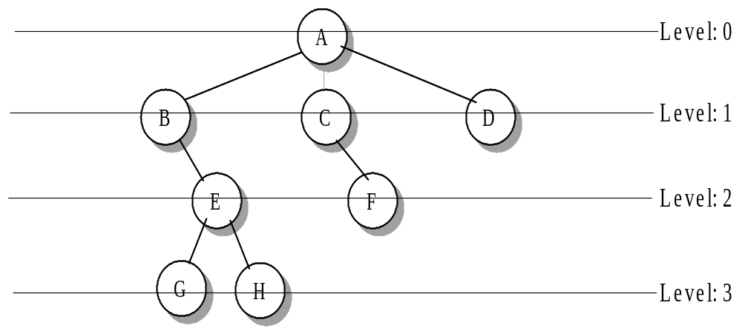
Tree Node Level and Path Length
The root node of the tree has level 0.
The level of any node is one more than the level of its parent
Leaf node G, H at level 3. Total number of level in a tree is 4.

Slide 9
Size and depth
The size of a binary tree is the number of nodes in it
  This tree has size 12
The depth of a node is its distance from the root
  a is at depth zero
  e is at depth 2
The depth of a binary tree is the maximum level of any leaf node
  This tree has depth 4
a
b
c
d
e
f
g
h
i
j
k
l

Slide 10
Height
a
A tree with N nodes has at least N-1 edges
There is exactly one path connecting any two
node of a tree.
b
c
d
e
f
g
h
i
j
k
l
The Height of a tree is the number of edges on the longest path
from root to the leaf node. Here height of tree =4
level=height+1

Slide 11
Balance
a
a
b
c
b
c
e
d
e
f
g
d
f
h
i
j
g
h
A balanced binary tree
i
j
An unbalanced binary tree
A binary tree is balanced if every level above the lowest is “full” (contains 2^{n} nodes)
In most applications, a reasonably balanced binary tree is desirable

Slide 12
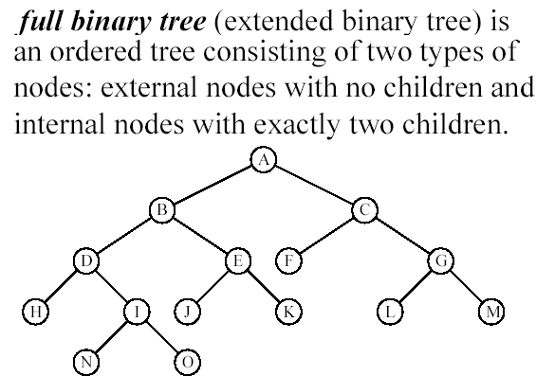

Full Binary Tree or Strict binary tree

Slide 13
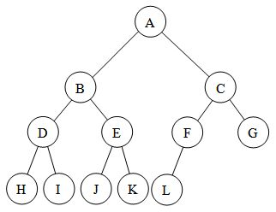

Complete Binary Tree
A complete binary tree is a binary tree in which every level, except possibly the last, is completely filled.

Slide 14
Height of complete Binary tree
The height h of a complete binary tree with N nodes is at most O(log N). Counting each level has the maximum number of nodes:
n = 1 + 2 + 4 + ... + 2^h
= 1+2^1+2^2+…+2^h=2^(h+1) – 1 (Addition of G.P)
therefore 2^(h+1)=n+1
taking log both side
h+1=log(n+1)
h = O(log n)

Slide 15
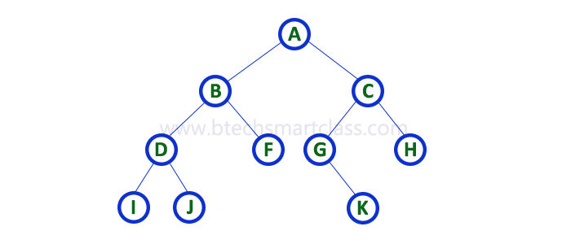

Array Representation of binary tree
To represent a binary tree of depth 'n' using array representation, we need one dimensional array with a maximum size of 2^{n+1} - 1.

Slide 16
Array Representation of binary tree
For any node at index n
1) Parent : Parent of a node at index lies at (n-1)/2 except the root node.
2) Left Child : Left child of a node at index n lies at (2*n+1).
3) Right Child : Right child of a node at index n lies at (2*n+2).
4) Left Sibling : left Sibling of a node at index n lies at (n-1).
5) Right Sibling : Right sibling of a node at index n lies at (n+1).

Slide 17
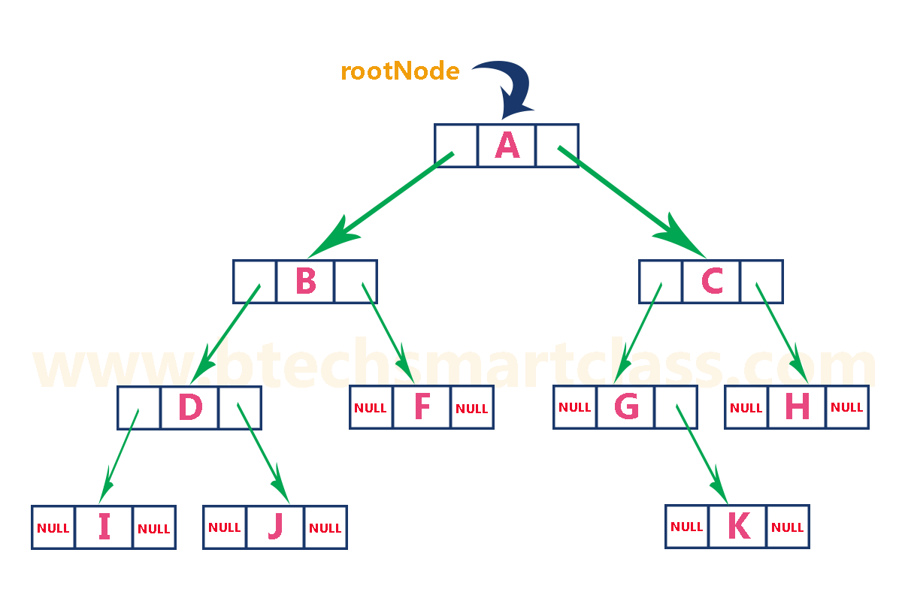
Linked List Representation of Binary Tree

Slide 18
#include<stdio.h>
#include<conio.h>
#include<alloc.h>
struct node
{
int data;
struct node *left,*right;
};
struct node *root;

Slide 19
void insert(int x)
{
struct node *p,*previous,*current;
p=(struct node *)malloc(sizeof(struct node));
if(p==NULL)
{
printf("\n Out of memory");
}
p->data=x; p->left=NULL; p->right=NULL;
if(root=NULL)
{
root=p;
return;
}

Slide 20
previous=NULL;
current=root;
while(current!=NULL)
{
previous=current;
if(p->data<current->data)
current=current->left;
else
current=current->right;
}
if(p->data<previous->data)
previous->left=p;
else
previous->right=p;
}

Slide 21
Tree Traversal(recursive)
Preorder
Inorder
Postorder
Preorder:
  Process the root
  Traverse the left subtree in preorder
  Traverse the right sub-tree in preorder
Inorder:
  Traverse the left subtree in preorder
  Process the root
  Traverse the right sub-tree in preorder

Slide 22
Tree Traversal(recursive)
Postorder:
  Traverse the left subtree in preorder
  Traverse the right sub-tree in preorder
  Process the root

Slide 23
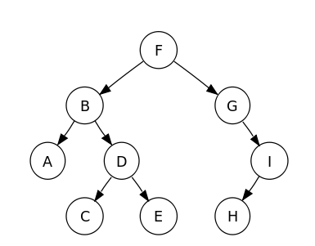
PreOrder Traversal
P(TreeNode)
Print (TreeNode.value)
If LeftPointer(TreeNode) != NULL Then
P(TreeNode.LeftNode)
If RightPointer(TreeNode) != NULL Then
P(TreeNode.RightNode)
F, B, A, D, C, E, G, I, H

Slide 24
Inorder Traversal
P(TreeNode)
If LeftPointer(TreeNode) != NULL Then
P(TreeNode.LeftNode)
print(TreeNode.value)
If RightPointer(TreeNode) != NULL Then
P(TreeNode.RightNode)
A, B, C, D, E, F, G, H, I

Slide 25
Post order Traversal
P(TreeNode)
If LeftPointer(TreeNode) != NULL Then
P(TreeNode.LeftNode)
If RightPointer(TreeNode) != NULL Then
P(TreeNode.RightNode)
Print (TreeNode.value)
A, C, E, D, B, H, I, G, F

Slide 26
Level Order
Let ptr be a pointer to the tree root.
while (ptr != NULL)
{
visit node pointed at by ptr and put its children on a FIFO queue;
if FIFO queue is empty, set ptr = NULL;
otherwise, delete a node from the FIFO queue and call it ptr;
}

Slide 27
Level-Order Example (Visit = print)
a
b
c
f
d
e
g
j
h
i
a b c d e f g h i j

Slide 28
Level Order Traversal
(using queue)
void levelOrder(ptnode ptr)
/* level order tree traversal */
{
int front = rear = 0;
ptnode queue[MAX_QUEUE_SIZE];
if (!ptr) return; /* empty queue */
enqueue(front, &rear, ptr);
for (;;) {
ptr = dequeue(&front, rear);

Slide 29
if (ptr) {
printf(“%d”, ptr->data);
if (ptr->left)
enqueue(front, &rear,
ptr->left);
if (ptr->right)
enqueue(front, &rear,
ptr->right);
}
else break;
}
}
+ * E * D / C A B

Slide 30
Print Arithmetic Expressions
inorder traversal:
  print “(“ before traversing left subtree
  print operand or operator when visiting node
  print “)“ after traversing right subtree
+
×
×
((2 × (5 - 1)) + (3 × 2))
2
−
3
2
((2 × (5 - 1)) + (3 × 2))
5
1

Slide 31
Construction of BST using IN and PRE order
The in-order and pre-order traversal of a binary tree are:
d b e a f c g and a b d e c f g, respectively.
What will be the post-order traversal for the same tree?
First construct the tree:
a
/ \
b c
/ \ / \
d e f g
Then traverse the tree in post order.

Slide 32
Q1. The inorder and preorder traversal of T yields the following sequences of nodes:
Inorder: E A C K F H D B G
Preorder: F A E K C D H G B
Draw the tree for above.
F
/ \
A D
/ \ / \
E K H G
/ /
C B

Slide 33
Construction of tree using POST and PRE order:
Q1. A binary tree T has 9 nodes. The postorder and preorder traversal of T yields the follwing sequences of nodes:
Postorder: E C K A H B G D F Preorder: F A E K C D H G B
Draw the tree for above.
It is not possible to construct a general binary tree using pre and post order.
If tree is complete we can construct the tree using pre and post order .

Slide 34
Steps:
In pre[], the leftmost element is root of tree. Here F is root.
The value next to F in pre[], must be left child of root. So, F is root and A is left child. How to find the all nodes in left subtree?
We know A is root of all nodes in left subtree. All nodes before A in post[] must be in left subtree. Now we know F is root, elements {E,C,K,A} are in left subtree, and the elements {H,B,G,D} are in right subtree.
recursively follow the above approach and you will get the tree.

Slide 35
Postorder: E C K A H B G D F Preorder: F A E K C D H G B
F
/ \
(E C K A) (H,B,G,D) *postorder
First traverse left sub tree, here A will be root. Now decide left and right sub-tree. Apply all the previous step, you can see in pre-order (A E K C D H G B) A is root and E will left sub-tree and (C,K) will be right side.
F
/ \
A (H,B,G,D) *postorder
E (C,K)
/
\

Slide 36
F
/ \
A (H,B,G,D) *postorder
E (C,K) *postorder
/
\
Traverse right sub tree, here K will be root. Now decide left and right sub-tree. Apply all the previous step, you can see in pre-order (K C D H G B) K is root and C will left sub-tree.
F
/ \
A (H,B,G,D) *postorder
        E K *postorder
        C
/
\
/

Slide 37
Same steps will be applied for right sub-tree. When no element is remaining, you will find final tree.
F
/ \
A D
/ \ / \
E K H G
C B
/
/

Slide 38
The End

